Slide 1
Predictive Analysis in T-20 Cricket: Estimation and Prediction of fantasy points for IPL Players
Pratheek Gogate
x22159789

Slide 2
Introduction
Sports analytics: Sports analytics involves using data analysis and statistical techniques to gain insights into various aspects of sports, including player performance, team strategies, and game outcomes. It helps teams make informed decisions, optimize player performance, and enhance strategies based on data-driven insights.
Cricket: Bat, bowl, field. Score runs, dismiss opponents. Popular sport with different formats, played worldwide.
IPL: The IPL (Indian Premier League) is a professional Twenty20 cricket league in India known for its fast-paced, high-energy matches. IPL analytics involves using data analysis techniques to evaluate player and team performance, optimize strategies, and predict match outcomes, offering valuable insights that shape the decisions of teams and coaches.

Slide 3
Research Questions
RQ1: How can we estimate and predict the fantasy points for players in IPL?
RQ2: What are the merits and demerits of each technique with respect to its performance and approach?
Research Aim: The purpose of this study is to evaluate the effectiveness of various models in forecasting fantasy points. By conducting a comparative analysis, this research can contribute to the understanding of differences between both the approaches.

Slide 4
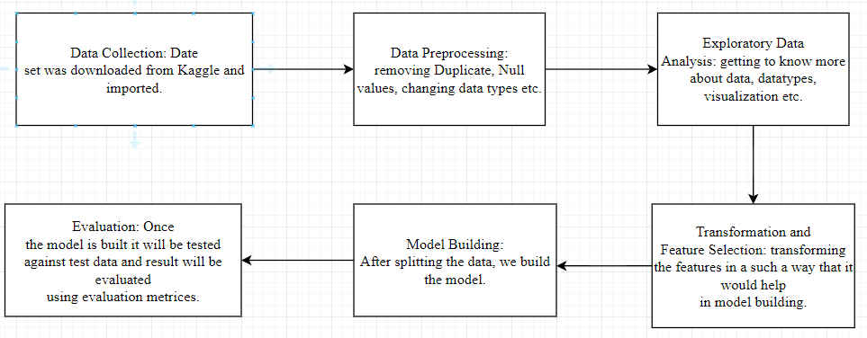
Flow diagram

Slide 5
Data Preprocessing
Ball by ball data is converted into player specific data by taking consideration into batsman on strike, then based on that runs scored, boundaries, sixes, half century, century, strike rates were calculated for each match.
Based on that Fantasy points are calculated with 1 point for each run scored, 1 bonus point for every boundary, 2 for sixes, 8 for scoring half century, 16 for scoring century.
Checked for null values and duplicate values.

Slide 6
Exploratory data analysis and transformation
Checked the data types and summary of the data to understand more about the data and also changed the datatype wherever it was necessary.
There were some features which were in non numeric format and we changed them into numeric format using data transformation.
For Prediction purpose we had to change the time series data into a input and output and in that case we used rolling window technique where we used loops in a such a way that for example first 10 matches were considered as input and then based on those matches fantasy points will be predicted for match 11 and then again from match 2 to 11 will be input and prediction will be done for match 12 and so on.

Slide 7
Model Building
Initially we used Linear regression, SVM linear, SVM polynomial for estimation purpose.
We built models with LSTM, BiLSTM, GRU for forecasting purpose.

Slide 8
Evaluation
For first approach we got a very good result with r square value of 0.99 for first 2 models and MAE and MSE scores were also very low.
The Problem with this approach was we were using current match data as well to estimate fantasy points and also we had just one data point to compare with test data and hence the result can depend on the data and we may not get the same accuracy for other data.
For Forecasting we did not get a good result as RMSE and MEA were high and it was around 20 for all the 3 models and hence the model is not a good fit for this data.
But the approach was right.

